Slide 1
Microsoft Teams – Authentication and Single Sign-on (SSO) with tabs & bots
Understand authentication and single sign-on (SSO) in Microsoft Teams apps

Slide 2

Overview
Authentication and authorization in Microsoft Teams apps
Microsoft Teams and single sign-on (SSO)
Implementing SSO in Microsoft Teams apps

Slide 3
Microsoft Teams and Single Sign-on (SSO)
Microsoft Teams SSO support added to in 2020
Tabs
Task modules (web experience)
Conversation bots
Reduces how often users are prompted to login to third-party services
Implemented using:
Azure AD application
Azure Bot Framework (for bots)
Client-side code in the app (for tabs & web-based task modules)

Slide 4
Register the Azure AD application

Slide 5
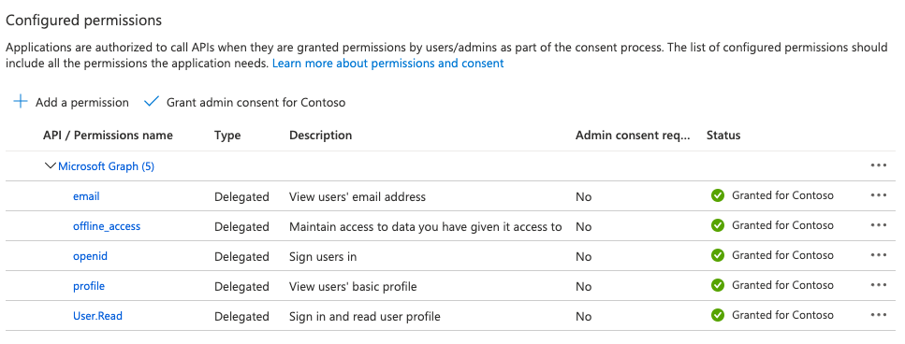
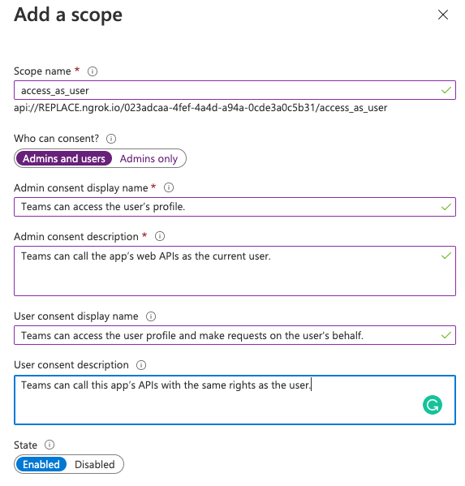
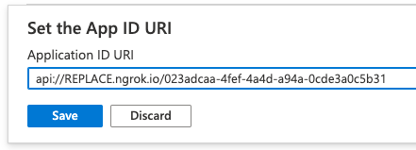

Slide 6
Associate the Microsoft Teams app with the Azure AD application
"webApplicationInfo": {
"id":
"023adcaa-4fef-4a4d-a94a-0cde3a0c5b31",
"resource": "api://app.com/023adcaa-4fef-4a4d-a94a-0cde3a0c5b31"
}
Link the app to the Azure AD app in the app’s manifest
Defined in the webApplicationInfo object
Id: Azure AD application’s [client] ID
Resource: URI of the add-in as listed in the Azure AD app registration

Slide 7
Demo

Slide 8

Summary
Authentication and authorization in Microsoft Teams apps
Microsoft Teams and single sign-on (SSO)
Implementing SSO in Microsoft Teams apps

Slide 9
Thank you.

